Slide 1
Services Technology
SupportAssist for business PCs and TechDirect
Features and capabilities launching with ProSupport Modernization 3.0
Customer Presentation
September 2021
Notes:
When challenges are coming at you quickly, you need support now, not next week. Our ProSupport Suite experts are ready to help 24x7, whether your team is working from home or in the office. For a single PC or your entire fleet, our predictive, proactive technology alerts you to hardware and software issues before they impact your end-users. You'll discover that every offer in this suite makes your job easier and your end-users happier.
This presentation will walk you through ProSupport Suite for PCs, logging into TechDirect and deploying SupportAssist. Let's get started -

Slide 2
Connect and manage PCs with actionable intelligence
ProSupport Suite for PCs takes advantage of connectivity technology & an intuitive online dashboard where you will centrally monitor and manage your PC fleet. Stay in control of better user experiences with:
Proactive and predictive detection for faster* issue resolution
Quick analysis of health, application experience and security scores on a single screen
Customized rules define remediation workflows
Automatic creation and deployment of custom update catalogs for Dell BIOS, driver, firmware and applications
*Based on a Principled Technologies report, “Diagnose and resolve a hard drive issue in less time with Dell ProSupport Plus” May 2020. Testing commissioned by Dell, conducted in the United States. Actual results may vary. Full report: http://facts.pt/ddv0ne9
Notes:
Once you connect your PC fleet with SupportAssist, you can centrally monitor and manage it from TechDirect, anytime, anywhere.
Our ProSupport Suite for PCs provides a range of support options to meet the needs of businesses from small companies to large enterprises using SupportAssist, our proactive and predictive technology and anticipate your team’s needs with data-driven insights on Health, Application Experience and Security.
If you need support to reduce IT time spent on routine tasks, we have you covered with 24x7 direct access to ProSupport engineers, onsite repairs on the next business day and automated, proactive issue resolution with telemetry driven insights.
Or if you need the highest level of support, ProSupport Plus includes all the features and benefits of ProSupport, as well as Accidental Damage service, actionable telemetry-driven insights and recommendations into PC performance and predictive technology that virtually eliminates unplanned downtime.

Slide 3
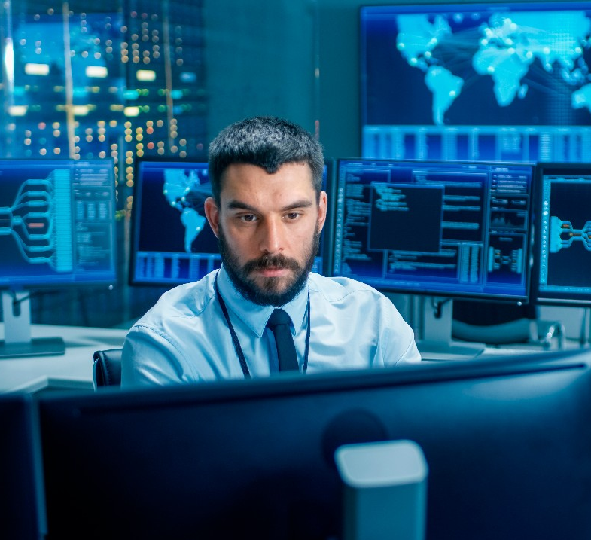
Modern, intelligent PC management at your fingertips
When IT is under pressure to deliver a better end-to-end PC experience, you need a portal that shows both the big picture and your next step across your entire team anytime, anywhere. TechDirect* provides:
End-to-end IT control throughout the PC lifecycle
Fleet-wide visibility and management with actionable insights
Flexibility to tailor your views and dashboards
*TechDirect features that require SupportAssist connectivity are not available on Linux, Windows RT, Android, Ubuntu or select Chrome based products. SupportAssist, when connected to TechDirect, automatically detects and proactively alerts Dell to: operating system issues, software upgrades, driver updates, malware, virus infected files, failures of hard drives, batteries, memory, thermal sensors, heat sinks, fans, solid state drives and video cards. SupportAssist, when connected to TechDirect, enables predictive analysis failure detection includes hard drives, solid state drives, batteries and fans (only ProSupport Plus and ProSupport Flex).
Notes:
When IT is under pressure to deliver a better end-to-end PC experience, TechDirect shows both the big picture and your next step across your entire team anytime, anywhere.
With TechDirect, we’re taking a potentially complicated path that could require countless tools and making it simple. Delivering the results IT leaders need for a modern, intelligent, self-service portal with an AI powered connectivity solution.
You will have a clear path for PC management at every step in our centralized, online customer portal.

Slide 4
An enhanced modern PC management experience
Easy access to data-driven differentiators in TechDirect
1
2
3
4
A unified, modern online user experience with easy navigation and PC management
Easily monitor, detect and track your entire Dell fleet or single PC from a customized dashboard showcasing new scores for health, application experience and security
Automated creation and deployment of custom catalogs for Dell BIOS, driver, firmware and applications
Create rules that detect and remediate issues remotely to help manage your Dell PC fleet performance
Notes:
At-a-glance, lets look at the data driven differentiators and features you want with TechDirect and SupportAssist:
We now have an ultra-modern user-interface, look & feel, that is more intuitive to support offer activation and navigation. An easier activation of advanced features, like SupportAssist for business PCs.
You can easily monitor, detect and track your entire Dell fleet or a single PC from a customized dashboard showcasing:
Hardware & OS performance (health data)
Security scores
Application experience
Issue remediation
Create custom catalogs to automate and control the performance of your Dell PC fleet. And create custom remediation rules to manage your Dell PC fleet performance.
This monitored and improved PC performance leads to fewer headaches and a more productive workforce.
Act on proactive and predictive data to prevent and resolve issues remotely, saving on downtime.

Slide 5
Simplify PC monitoring, tracking and management
Easily monitor and manage from your TechDirect dashboard:
Gain insights to your entire Dell PC environment with central access
At-a-glance audit trails and performance indicators provide transparency across your fleet
Control configuration for customized experiences, including options for:
End-user tool usage and interaction
Data collection permissions
Alert behaviors and notifications, including sending alerts to tools, like ServiceNow
Automated scans and remote remediation
Centrally manage
Optimize, update & protect
Prevent downtime
Gain insight
Notes:
TechDirect can help you simplify asset management and alerts for your Dell PCs. It can be configured to send PC issue alerts to your account if you have ProSupport, ProSupport Flex or ProSupport Plus. This way you have one centralized place from which to manage all your end user alerts, from KPIs to audit trails.
Depending on your IT policies and preferences, you can choose to enable the end-user interface as well as configure the functionality that will be accessible to your employees.
You will have the flexibility to disable any of the features.
Configuration settings put you in control of how incoming alerts are managed. You can configure alert settings to auto-forward alerts to Dell to become support requests, setup auto-dispatches or your alerts can be individually managed from the Alerts list.
Notifications will be sent to you via email or the TechDirect Message Center if you haven’t acted upon an alert after a specified number of days. All of these configuration settings are designed to make managing PC support easier. You can even have notifications routed to your existing tools, like ServiceNow.

Slide 6
Deliver hassle-free experience anytime, anywhere
Stay ahead of potential performance issues
Optimize PC experience by cleaning files, tuning performance, optimizing Wi-Fi networks and more
Protect your environment with access to security scores and virus and malware removal
Automate creation and deployment of custom update catalogs for Dell BIOS, driver, firmware and applications
Create customized rules that detect and remediate issues, remotely
Centrally manage
Optimize, update & protect
Prevent downtime
Gain insight
Notes:
There are many factors that could be impacting PC performance. Our health, security and application experience scores help you to stay on top of these issues.
Whether an end-user is requesting a fix for an un-diagnosed issue or IT is looking to get ahead of potential performance issues, you can now take action directly from TechDirect.
You have a dashboard view that shows PC recommendations across your fleet, with the ability to customize the list of PCs and actions taken for multiple systems in your environment. With SupportAssist, you have customized catalog creation based on detected install base and direct deployment via our integration with cloud-based technology. (DCRM)
With our remediation platform, we provide flexibility for IT admins to tailor their remote remediation using customized rules for workflow creation, execution and reporting. IT admins will be able to generate their own scripts at the time of launch with additional scripts post-launch.
Updates are queued for the next time PCs are online. Recommendations are classified as critical, recommended and optional – and you are in control of who
receives updates.
Your dashboard allows you to easily review current status anytime, anywhere.
Our hassle-free experience allows you to drill down into PC Recommendations and take action immediately with a remote session.

Slide 7
Get smarter support with AI that predicts issues
How does Dell use AI to predict issues?
Centrally manage
Our AI engine processes the data using machine learning
We alert and contact you
to proactively resolve
Failure avoided
Optimize, update & protect
Future failure is detected
Prevent downtime
Telemetry data is collected by connecting to TechDirect using the SupportAssist, 256-bit encryption and SSL protocol
Your part is replaced before a failure and you stay productive
Gain insight
Notes:
When sharing the predictive support feature with customers, we often get the question “How does it work?”
The technology behind our predictive capabilities uses artificial intelligence to get ahead of issues. This example scenario shows an end user with SupportAssist enabled on a ProSupport Plus device.
Telemetry data that is processed by our AI engine, applying machine learning to the data, identifying patterns that indicate a potential failure.
The end user’s IT manager automatically receives a predictive alert warning about a hard drive failure.
The IT manager adds a note to the alert detailing the end user’s contact information.
The alert is then forwarded to Dell to become a support request.
The troubleshooting information Dell needs to begin working the issue is attached to the request.
Dell then contacts the end user directly and replaces the hard drive.
Results
The inconvenience to the end user is minimal as the drive was replaced at a time convenient for them. The end user was also able to back up their data before the scheduled drive replacement. Additionally, the IT manager’s effort was minimal as he only had to add a note and forward the alert to Dell.

Slide 8
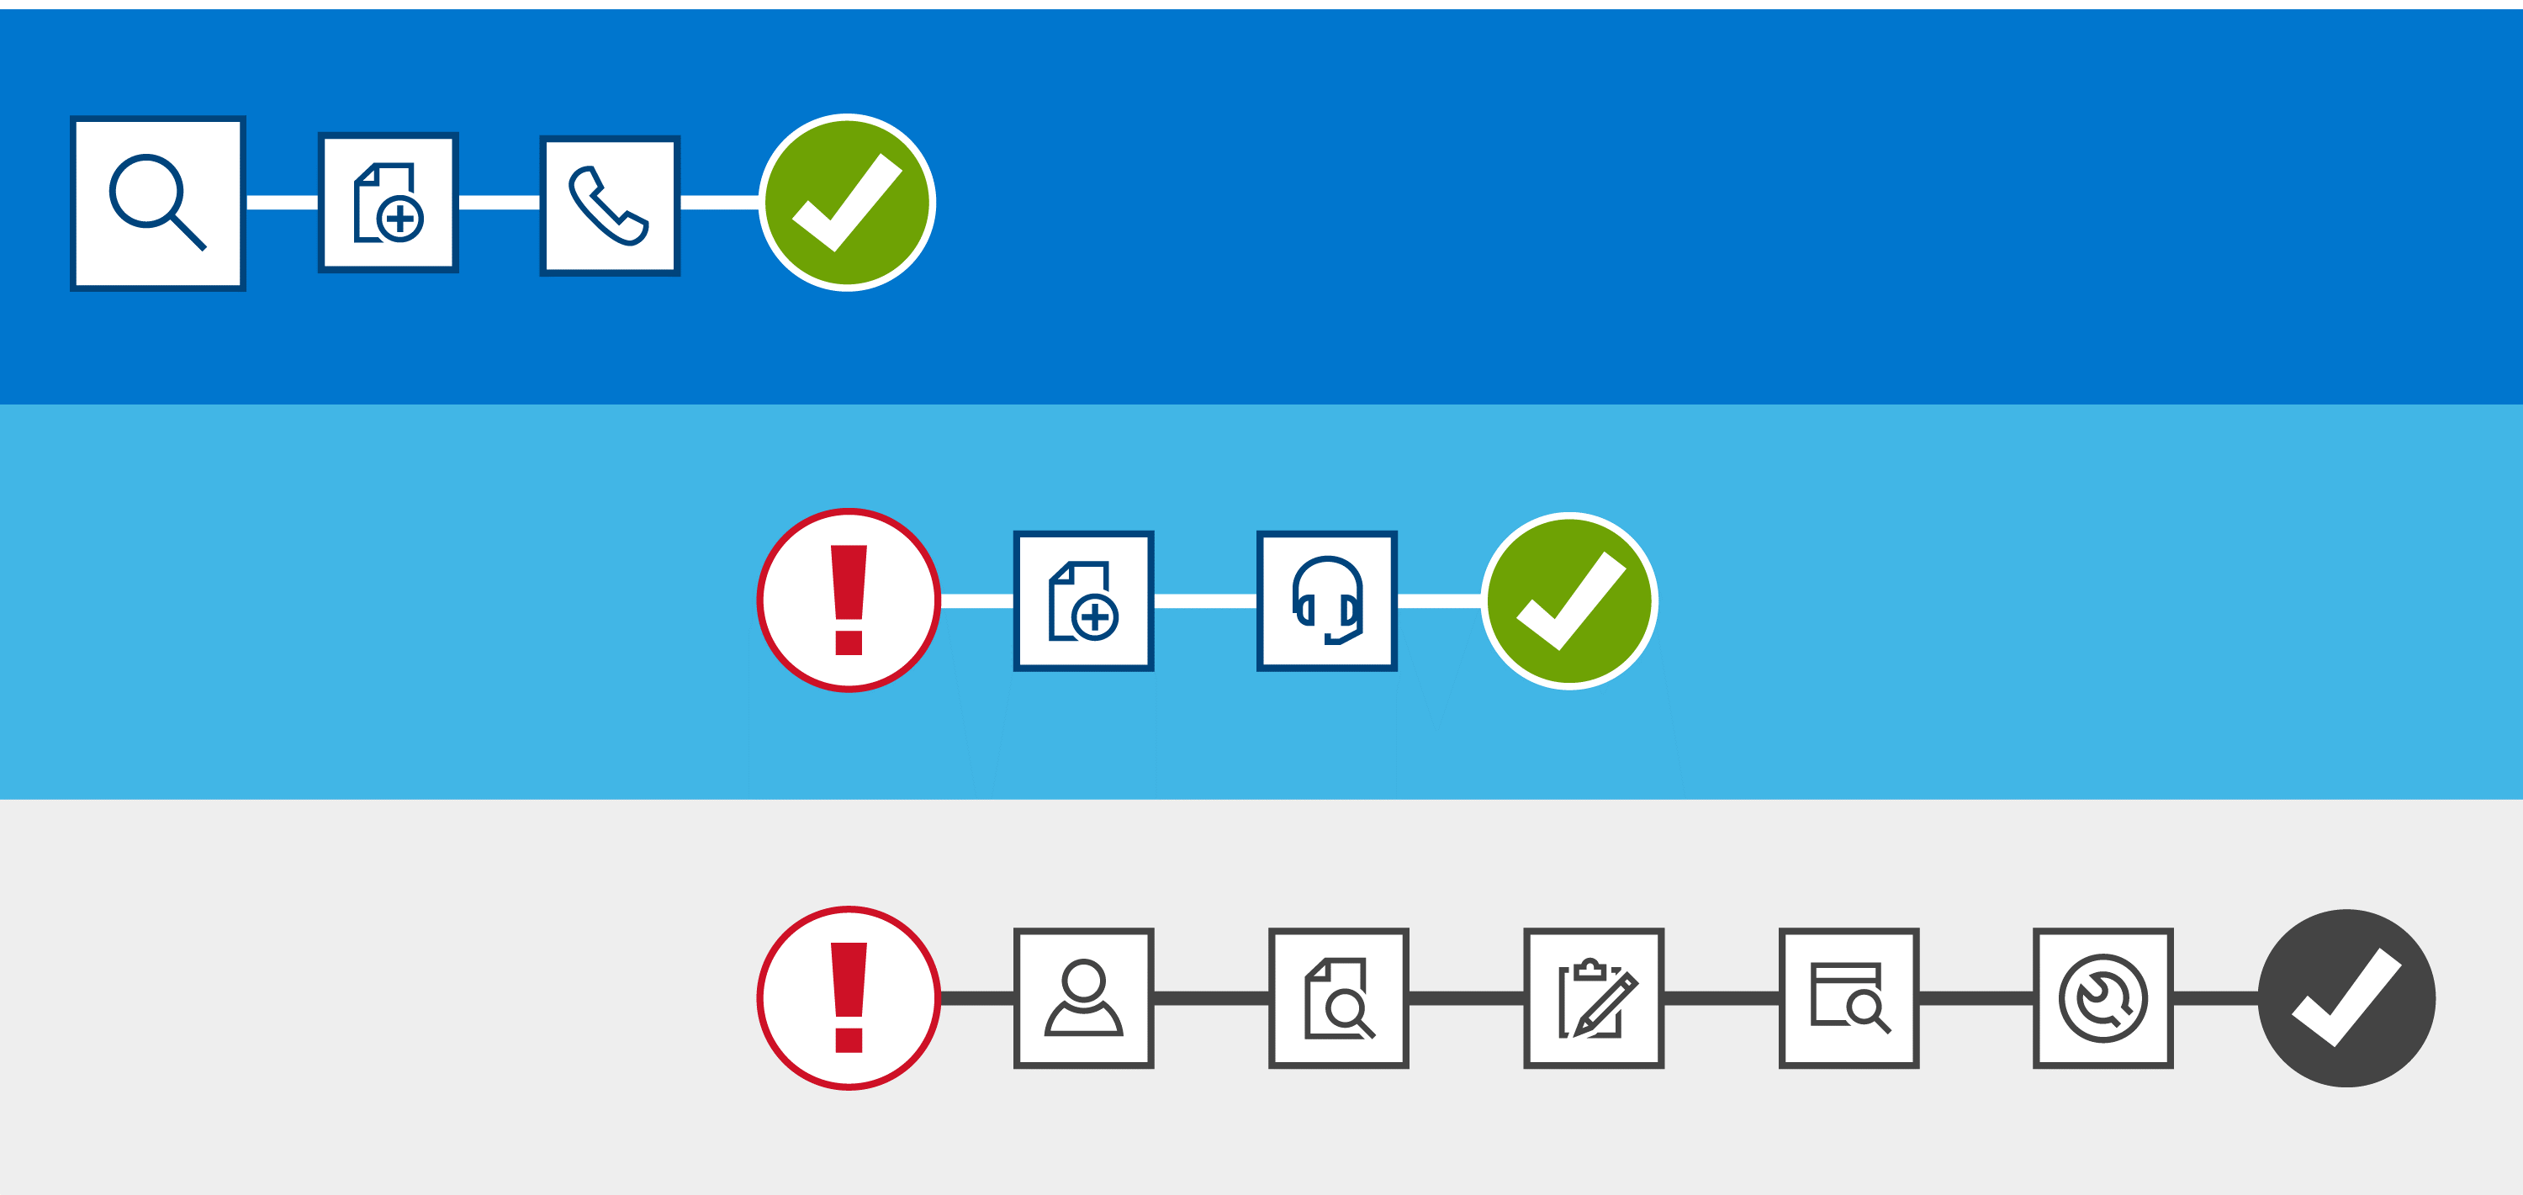
Expedite PC issue resolution in fewer steps
Automated predictive support with ProSupport Plus and ProSupport Flex
PREDICTIVE
Centrally manage
Failure
Prevented
Predict Issue
Auto case creation
Dell contacts customer
Automated proactive support with ProSupport, ProSupport Plus and ProSupport Flex
Optimize, update & protect
Fault Occurs
Auto case creation
Dell contacts customer
Prevent downtime
Traditional manual support
Resolved
Customer contacts Dell
Verify service contract
Manual case creation
Gather system state data
Troubleshoot
Gain insight
Notes:
SupportAssist is a smarter way to get resolution and the key benefit is expedited issue resolution.
Let’s walk through this illustration:
The grey box at the bottom of this slide shows traditional support and the many manual steps it requires for customers to get resolution after a fault has occurs. The blue boxes represent the path to resolution when SupportAssist’s predictive and proactive automated support is enabled through the ProSupport Suite for PCs. You can see the steps are reduced by almost half with proactive resolution. When a fault occurs, a support request is automatically created, and we proactively contact you about resolution. With predictive, the failure is prevented before you would initiate a typical support process – greatly reducing impact to the customer.
With SupportAssist, you no longer need to
Identify a fault has occurred
Locate their service tag
Remember their service contract details
Find tech support’s phone number
Describe the issue
Gather system logs
Send system logs to Dell
Hold while tech support troubleshoots
The key thing to remember is with ProSupport or ProSupport Plus with SupportAssist the steps to resolution are reduced by almost half.

Slide 9
Simplify PC monitoring, tracking and management
Focus on the health, application experience and security of your Dell fleet and take-action from a centralized location
Centrally manage
Application Experience
Health
Security
Optimize, update & protect
Monitor, detect, track and trend device component stability using hardware and software performance and OS crash analysis
Keep a pulse on user experience by monitoring application utilization & performance
Visibility to risks and threats to a single PC or your fleet using assessments from Dell Trusted Device
Prevent downtime
Gain insight
Notes:
Your customizable dashboard allows the IT admin to zoom in on the end-user experience by identifying areas of success and opportunities for improvement with device health, application experience and security from a single Dell PC or your entire Dell fleet.
You can easily monitor, detect, track and trend device health across hardware and OS.
Application experience allows you to keep a pulse on your end-user experience by monitoring performance.
The security score helps you understand the percentage of your Dell fleet that may have greater risk using binary assessment of BIOS IoA, BIOS verification, TPM enabled, BIOS admin password enabled, antivirus, firewall and disk encryption enabled.

Slide 10
Anticipate your team’s needs with data-driven insights
Make better data-driven decisions with health, application experience and security scores that zoom in on performance issues and your fleet’s needs:
Hardware utilization including memory, CPU, GPU, battery and storage
Software utilization including application usage and crashes
Device stability including OS crashes and PC system events
Device age helps anticipate and plan for hardware refreshes
Centrally manage
Optimize, update & protect
Prevent downtime
Gain insight
Notes:
When performance issues happen in your business, you hear about them and are expected to solve the problem as quickly as possible to mitigate downtime. What if you had insight into performance issues and could begin implementing solutions before you are alerted to the problem by the end user?
Our SupportAssist KPI reports illustrate the positive way the offer benefits you.
IT managers and decision-makers can gain insight into key performance metrics like hardware utilization, software utilization, device stability and device age by monitoring the health of PCs from a central dashboard. You can now proactively identify and resolve issues with visibility and ease. When it comes time for refreshes, you have more data at your fingertips to make better decisions.
From your customized, central dashboard, you can view these insights on each PC or the entire Dell fleet to zoom in on specific issues and needs for your end-users.

Slide 11
Why Dell?

Slide 12
Why TechDirect with SupportAssist?
80+
More than a decade of self-service online support with 250K support requests & 1.2 million self-dispatches globally each year¹
Trusted by 45K enrolled companies and 2,500 channel partners enabled to centrally manage PCs
Million Connected devices globally, receiving automated, proactive, support²
Security first. Secure real time monitoring that collects only the information needed to resolve issues, keeping it secure in the process
We have the scope and scale to manage the entire process, end-to-end, to save you from multiple tool headaches
1 Based on an internal analysis of Dell Technologies portal data including support requests, self-dispatches and users as of April 2021
2 Based on an internal analysis of Dell Technologies connectivity and portal technologies for enterprise and client systems as of April 2021
Notes:
So, you’re probably thinking, all service providers provide a customer portal – what’s the big deal?
TechDirect is a portal that has evolved to provide a single-stop solution for end-to-end PC management. If you need enterprise solutions, we have that too. Leveraging our scope and scale to save you from multiple tool headaches for…
Better, self-service support experiences:
With more than a decade of self-service online support, bringing in 250K support requests and 1.2 million self-dispatches globally, each year.
A secure, connected device experience:
With real time monitoring that collects only the information needed to resolve issues, keeping it secure in the process
Install base of 80 million and counting connected devices that rely on automated, proactive support and help inform evolving data science that can detect and resolve issues with acuity
With an existing reputation to get global direct and partner customers what they need to centrally managing their PCs:
45K enrolled businesses in the portal
2,5000 channel partners

Slide 13
Privacy and security is paramount
SupportAssist only collects the information needed to resolve issues and keeps it secure
You are in control.
Information is safe during transport and storage.
Authorization must be given before information including configuration, event notifications and system diagnostic information are collected.
The customer has to opt-in for software inventory information to be collected for issue diagnosis.
IT admins managing alerts in SupportAssist can review the information collected here.
Transport
Storage
256-bit encryption
Secure web ports
Firewall protected one-way communication from the customer’s site to Dell
Device usage and login credentials are never collected
Proxy credentials, if supplied, are encrypted and never leave the customer site
Dell My Account authentication leverages anti-forgery mechanisms
Learn more about how SupportAssist securely monitors your environment
Notes:
One of the main questions we get from customers is around data security and privacy.
No personal or business data is collected – privacy and security is paramount.
SupportAssist collects system state information, including configuration information, event notifications and system diagnostic information.
You are in control.
They must authorize their system state and software inventory information to be collected before this information is used to diagnose or troubleshoot issues.
Their system state information is safe.
System state information is protected during transport and storage. During transport, the information is encrypted and communication is only allowed to go one-way – from you to Dell. Additionally, device usage and login credentials are never collected.
During storage, supplied proxy credentials are encrypted and never leave your site. An added layer of safety is provided with Dell MyAccount’s anti-forgery mechanisms. You can learn more about our privacy and security measures in this security white paper.

Slide 14
Backup

Slide 15
Connect Dell PCs for uninterrupted performance
Resolve issues up to 84% faster than our competition with real-time monitoring that proactively identifies and resolves issues
Virtually eliminate unplanned downtime by predicting issues before they happen
Get smarter support with AI that predicts issues
Deliver hassle-free experience anytime, anywhere
Ensure productivity with updates to drivers, BIOS and firmware
Optimize PC experience for your team
Protect your environment with virus and malware removal
Make better data-driven decisions based on refresh and utilization tracking
Get ahead of disruptions with insight into performance impacting issues
Anticipate your team’s needs with data-driven insights
Notes:
ProSupport Plus Benefits
TechDirect provides more control, automation and optimization once enabled.
As an IT team, you will now have access to a single source of truth, with:
The ability to configure, view, manage and group their assets by site location or other grouping preferences
Manage alerts and notifications centrally.
With data streaming in from your fleet’s devices securely, you can benefit from real-time AI that gets you ahead of issues:
Automated case creation and proactive issue resolution
Receive predictive notifications of hard drive, battery, and thermal fan failures
With end users increasingly distributed, and reliant on technology more than ever – these tools will help you deliver hassle-free experience anytime, anywhere:
Manage updates including drivers, BIOS and firmware, optimizations and virus/malware removal for ProSupport Plus customers remotely – sending updates to a single system, or a group of PCs in your fleet.
And anticipate your team’s needs:
Gain insight into key indicators of PC performance issues including CPU, storage, and battery utilization information with Service Intelligence for ProSupport Plus customers

Slide 16
Smarter support, even without an IT team
Leverage SupportAssist for out-of-the-box managed benefits
Most common experience for small business customers: managed by users locally, on-the-box
For teams who do not choose to manage their PCs centrally, users can manage features locally on each PC
SupportAssist is installed on most Dell PCs with Windows 10. It is also available for download at dell.com/SupportAssist.
SupportAssist
For teams with an IT team and/or want to manage systems centrally from the cloud, connect to TechDirect
Deploy SupportAssist to your fleet of PCs and manage remotely in TechDirect.
TechDirect
Notes:
To take advantage of all the benefits of ProSupport Plus small businesses will typically utilize SupportAssist, our on-the-box, user managed automated, proactive and predictive support solution.
If small businesses are interested in how to manage their PCs centrally, especially as they grow their IT team – they can register in the TechDirect portal to deploy and manage this centrally managed toolset. However, this will require that they deploy and run the SupportAssist solution at that time.
After registering in TechDirect, they will enable the Connect & Manage feature and deploy the Secure Connect Client to their end-user devices enabling telemetry data to interact with your centralized IT hub and Dell IT securely. This process will additionally uninstall SupportAssist, replacing with the Secure Connect Client.
They will configure their settings and use their preferred deployment tool to push the software to their fleet.
Once the PCs are connected, you will be able to monitor and manage from your dashboard.
Features will depend on your service entitlement, unlocking more features with ProSupport and ProSupport Plus for PCs.

Slide 17
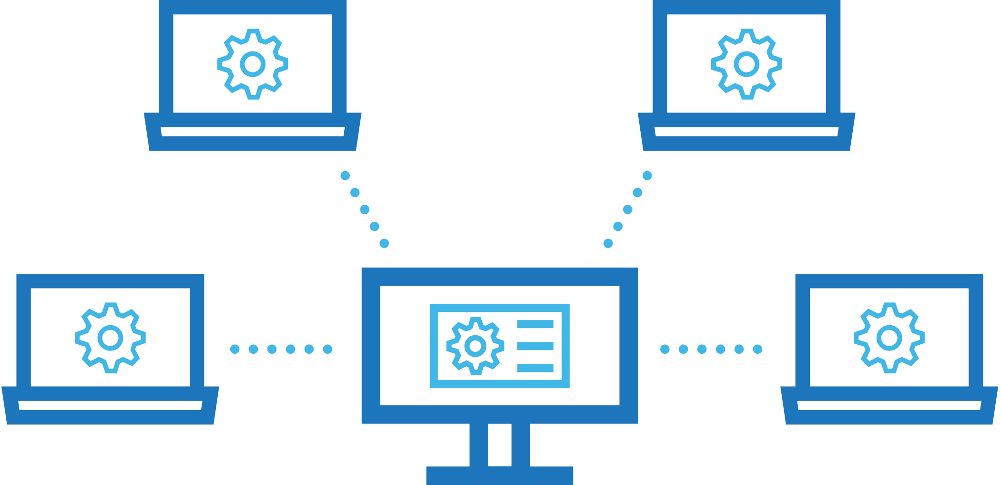
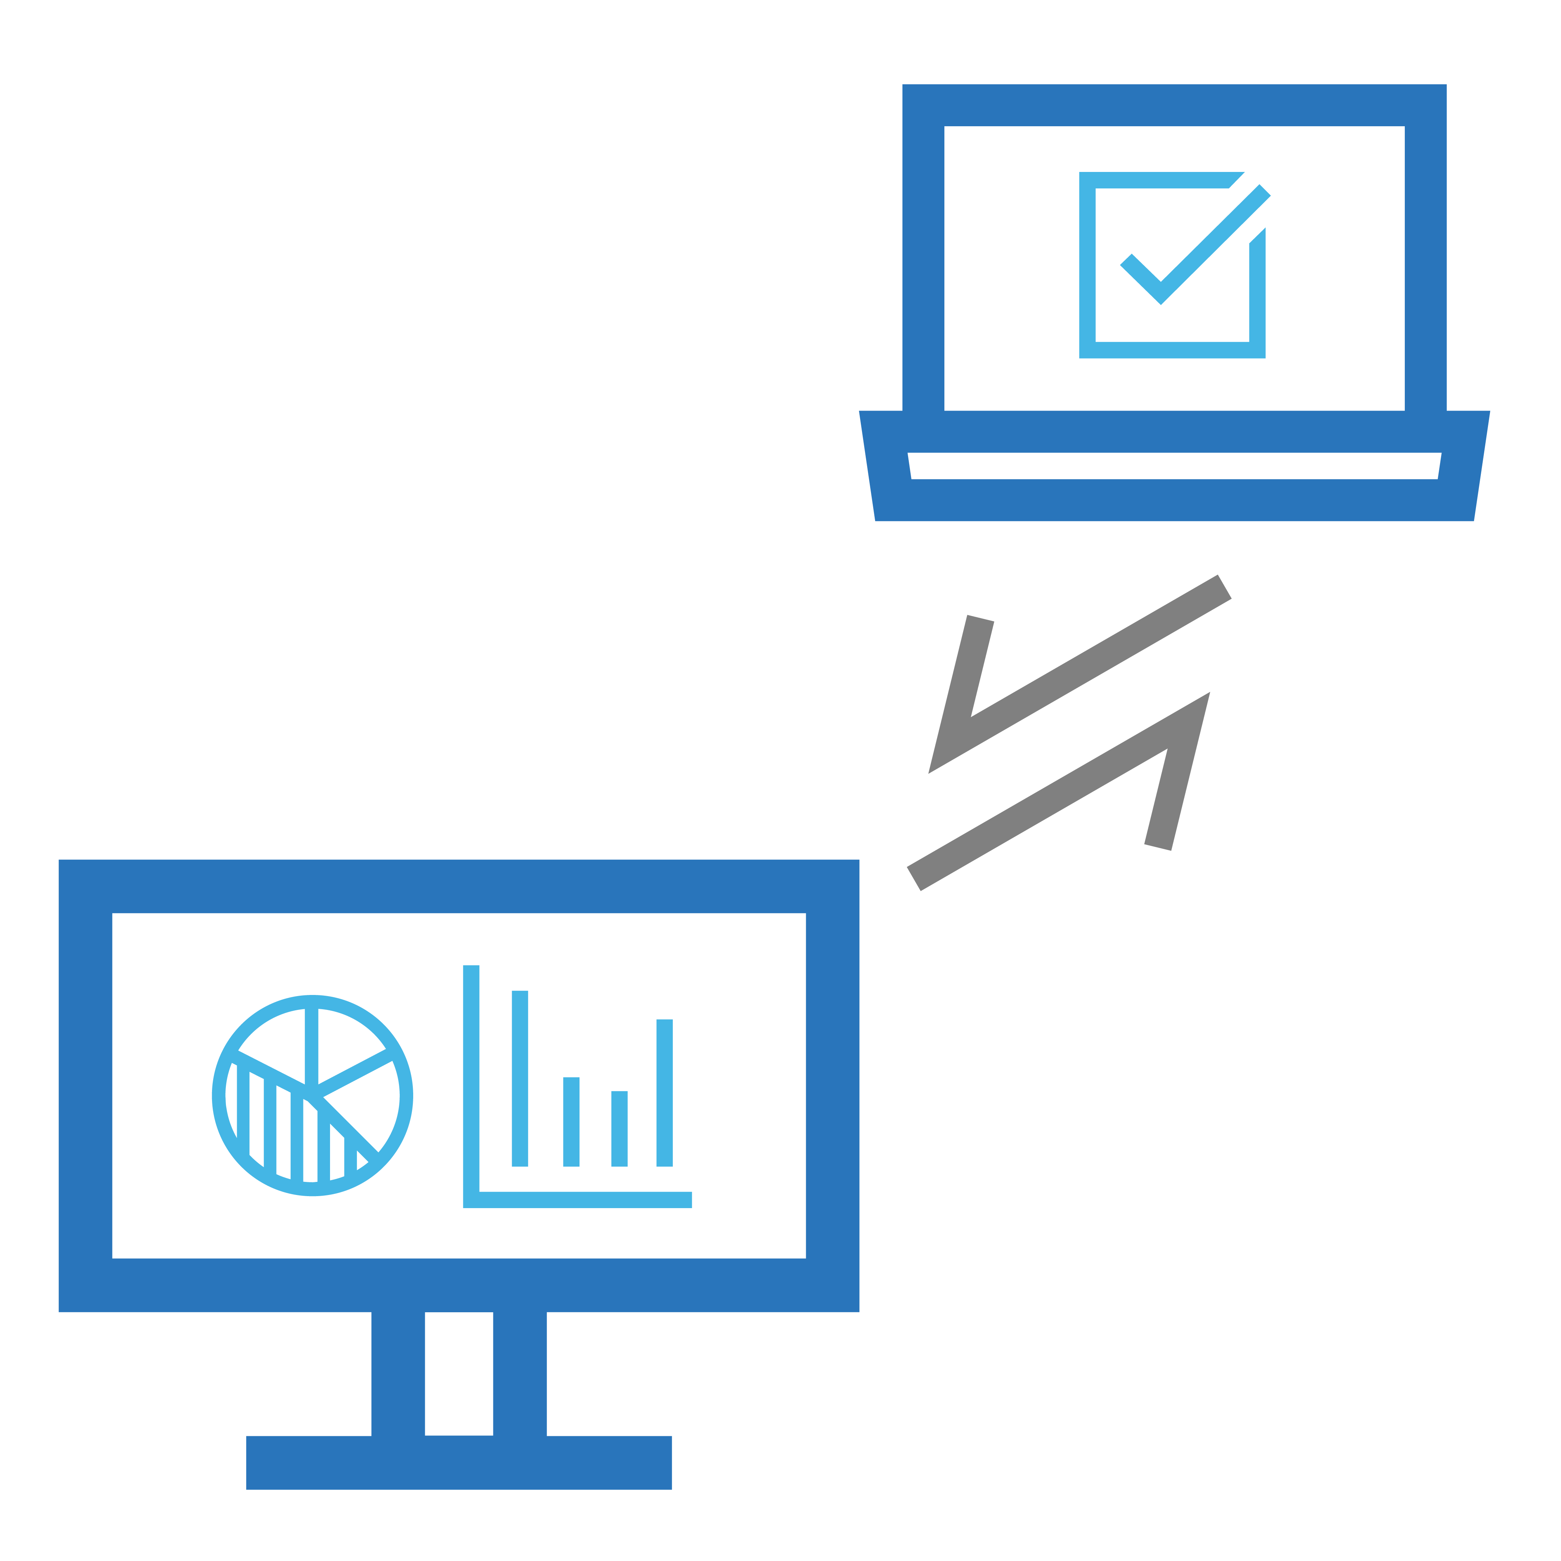
Let’s get started, connect to TechDirect
ProSupport Suite customers centrally manage and monitor PCs – anytime, anywhere
1
2
3
Register your company for an account in TechDirect
Deploy SupportAssist for business PCs to your fleet
Remotely manage and monitor PCs centrally, unlocking additional features with
ProSupport Suite for PCs
Share our getting started guides with your customers:
Asset Recovery with TechDirect
Connect & Manage with TechDirect
PC Management with TechDirect
Notes:
To take advantage of all the benefits of ProSupport Plus, IT administrators will setup an account in TechDirect.
After registering in TechDirect, enable the Connect & Manage feature and deploy SupportAssist to end-user devices enabling telemetry data to interact with your centralized IT hub and Dell IT, securely.
Configure settings and use your preferred deployment tool to push the software to your fleet.
Once the PCs are connected, you will be able to monitor and manage from your dashboard.
Features will depend on your service entitlement, unlocking more features with ProSupport and ProSupport Plus for PCs.
Regardless of entitlement, it is critical that you provide the Getting Started with Device Management in TechDirect guide that includes links to all the helpful resources for you including videos, demo, webinars, technical documentation and more.

Slide 18
Dell ProSupport Suite for PCs
 | Basic Hardware Service | ProSupport | ProSupport Plus | ProSupport Flex⁷
Technical support the way it works best for you (phone or chat) | Business hours | Phone 24x7 | Phone 24x7 | Phone 24x7
Hardware repair to reduce productivity downtime | Varies | Onsite NBD¹ | Onsite NBD¹ | Onsite NBD¹
Direct access to in-region ProSupport experts for hardware and software² issues |  |  | Priority Access | 
Command center monitoring for on-time parts and labor delivery |  |  |  | 
Service Account Manager for designated account reporting and planning⁶ |  |  |  | 
Hard drive retention after replacement⁵ to secure privacy of data |  |  |  | Optional
Repairs or replacements for accidental damage⁴ |  |  |  | Optional
TechDirect³ is your online portal to connect and manage your Dell fleet: |  |  |  | 
Self-service case management and parts dispatch |  |  |  | 
Quick analysis of health, application experience & security scores |  |  |  | 
Proactive issue resolution with automated detection, case creation & support |  |  |  | 
Utilization metrics uncover performance issues and trends |  |  |  | 
Predictive issue detection and resolution before failures reduce disruptions |  |  |  | 
Automatic creation and deployment of custom catalogs for Dell BIOS, driver, firmware and applications provide remote and seamless updates |  |  |  | 
Customized rules allow you to define remote remediation workflows |  |  |  | 
What you should expect from world-class support:
Dell doesn’t stop there. We do more to support you:
¹ Onsite availability varies by country and service purchased. Onsite service after remote diagnosis.² Software support with collaborative 3rd party assistance. ³SupportAssist not available on Linux, Windows RT, Ubuntu or Chrome based products. SupportAssist automatically detects and proactively alerts Dell to: operating system issues, software upgrades, driver update=es and patches, malware, virus infected files, failures of hard drives, batteries, memory, internal cables, thermal sensors, heat sinks, fans, solid state drives and video cards. Predictive analysis failure detection includes hard drives, solid state drives, batteries and fans.⁴ Accidental Damage service excludes theft, loss, and damage due to fire, flood, or other acts of nature, or intentional damage. Customer must return damaged unit. Limit of 1 qualified incident per contract year. ⁵ Hard drive retention is not available on models with a soldered hard drive, Chromebooks or Venue tablets, except the Venue 11 Pro.. ⁶Available for ProSupport Plus customers with 500 or more ProSupport Plus systems ⁷Customers must commit to purchase 1,000 Dell client assets with ProSupport Flex within 12 months.
Notes:
Provide a brand new experience for IT Admins and their end users that will forever change the way they think about support.
You can add Keep Your Hard Drive warranty and Accidental Damage to ProSupport. However, it’s not the best option for you as it’s more expensive than ProSupport Plus (without all the advantages of ProSupport Plus).

Slide 19
Disclaimers

Slide 20
SupportAssist for business PCs disclaimers
Availability Not available on Linux, Windows RT, Android, Ubuntu or select Chrome based products.
Proactive Capabilities
Windows OS: SupportAssist automatically detects and proactively alerts Dell to: operating system issues, software upgrades, driver updates and patches, malware, virus infected files, failures of hard drives, batteries, memory, internal cables, thermal sensors, heat sinks, fans, solid state drives and video cards.
Chrome OS: SupportAssist for Chrome OS proactively alerts Dell to: operating system issues, failures of hard drives, batteries, memory and internal cables.
Predictive Capabilities
Windows OS: SupportAssist with Windows OS Predictive analysis failure detection includes hard drives, solid state drives, batteries and fans.
Chrome OS: SupportAssist for Chrome OS predictive issue detection includes battery.
ProSupport Claims Proactive: Based on an April 2020 Principled Technologies test report, “Diagnose and resolve a hard drive issue in less time with Dell ProSupport Plus.” Testing commissioned by Dell, conducted in the United States. Actual results will vary. Full report: http://facts.pt/ddv0ne9
Predictive: Based on a Principled Technologies test report, “Dell ProSupport Plus with SupportAssist warns you about hardware issues so you can fix them before they cause downtime” dated April 2019. Testing commissioned by Dell, conducted in the United States. Actual results will vary. Full report: http://facts.pt/0xvze8
Notes:
Add security/scores disclaimers- who do we work with for legal disclaimer reviews (if we add copy)

