Slide 1
Client Deployment
An overview for channel partners

Slide 2
The value you’ll get today
Understand the landscape and differentiators of Dell’s standard deployment offers
Know how to match these offers to customer needs and partner needs
See the opportunities to complement your own capabilities to increase your profitability
Understand the benefits and opportunities for deployment co-delivery
Know where to go for more information
Objective:
To provide channel sales and partners with the understanding on how to differentiate, position and sell the full portfolio of Dell deployment services
Result:
Empowered channel sales teams who know how to increase profitability with deployment services
On-target, profitable transactional and solution resells of our deployment portfolio
More channel partners motivated to attain the client deployment co-delivery competency to increase profitability with Dell

Slide 3
Dell Client Deployment Services
Create deployment efficiencies, tailor solutions, and help customers evolve faster, easier
Dell Technologies helps you meet a broad range of needs with our portfolio of standard deployment services:
Save in-house IT teams deployment and system handling time with our factory services
Let our team cover on-site installation across your customers multiple global sites
Launch day one end-user productivity with Dell Provisioning as a standalone service or via ProDeploy for Client or ProDeploy Plus for Client
Close a new hardware deal faster, leveraging the resale of legacy systems with Asset Resale and Recycling Services
Choose how and when you want to co-deliver deployment services when you have earned the client co-delivery competency

Slide 4
Dell Client Deployment Portfolio
ProDeploy Client Suite
Asset Resale
& Recycling
Configuration Services
Client Installation
Services
Notes:
Dell deployment services help you support customers of all shapes, sizes, and infrastructure types with the right Dell services solution to get new systems up and running.
The portfolio is made up of standard offers, which cover the essential phases for a successful deployment.
Depending on the customer environment and requirements there is the :
ProDeploy Client Suite: A full-process collection of set up and deployment activities aimed at medium to large scale deployments where a high degree of coordination and ongoing management is required.
Client Installation Service: For customers who need simpler, more straight forward deployments. Perhaps they don’t have the resources to deploy or would rather spend their time on core business taks.
Configuration Services: A range of factory services that prebuild systems in the Dell factory, saving in-house IT teams or channel partner deployment teams valuable on site time and enabling a customer to tailor new systems to meet their specific needs
Asset Recycling and Recovery (ARR) Services: To help customers return leased systems, and/or recycle hardware based on established global or regional standards, and/or realize value from old or out-of-use hardware.
Dell standard deployment offers give our partners the ability:
To turn quote request around at high velocity
Clearly set out a starting point of what is in or out of the service and lead the discussion
Tailor the standard service through the standard add-on modules and features
Where authorized co-delivery partners can deliver some of the service activities using their own staff and be reimbursed by Dell
Add partners own complementary services to complete an entire lifecycle solution for their customer
There’s an offer for every customer need and every customer type, with flexibility to tailor built-in.
You choose which offer fits best
You decide how to deliver services and how to achieve optimal profitability
You leverage our staff and tools to extend your reach

Slide 5
Deployment offers by portfolio area
ProDeploy Client Suite
Configuration Services
Client Installation
Services
Asset Resale and Recycling
Basic Deployment
ProDeploy
ProDeploy Plus
Asset Tagging and Reporting
BIOS/Settings
Imaging
Dell Provisioning
Client Installation
Trip Charge
Client Storage
Optional add-ons
Data Sanitization
Asset Return
Asset Recycling
Asset Resale
Notes:
Let’s break down the deployment offers by features
ProDeploy Client Suite is the flagship offers covering all critical aspects of deployment. There three offers:
Basic Deployment
ProDeploy
ProDeploy Plus
Big ideas about this offer:
Full deployment service process with flexibility to tailor.
Ideal when two or more configuration services and imaging or provisioning are needed
[if it applies] ProDeploy for Client with the integration of Workspace ONE factory provisioning is a foundational element in establishing a Unified Workspace environment
Partner can co-deliver the onsite services to improve profitability
Configuration Service – in-factory capabilities that drive deployment efficiencies
Tailor settings to meet specific customer needs
Accelerate deployments and end-user productivity
Client Installation Service – onsite experts get the system up and running quickly and efficiently
Three base offers with optional add-ons
Client Installation (the primary Base offer)
Trip Charge and Client Storage (base offers that can combine with Client Installation, as needed)
Client Installation Service add-ons include:
It’s a modular offer with three, combinable Bases:
Client Installation
Trip Charge
Client Storage
And a broad set of optional add on offers, which include things like
Client configuration
OS or Image
Extra Technician Time
Component Install
Packaging Management
Client Staging
Software Installation
Big ideas to convey about this offer:
This offer delivers on-site deployment services
It’s modular and flexible in all the ways that help you meet a customer’s needs
Flexible add-ons help you tailor
Complement your own services and/or co-deliver
Asset Resale & Recycling (ARR) Services
End of life solutions
Use residual value to fund a portion of your system refresh
Get help meeting company Eco-policy goals for technology end of life
Secure disposition

Slide 6
Identifying the right complement to your capabilities
Earn rebates and enhance tier attainment by adding the right Services
ProDeploy Client Suite
Configuration Services
Client Installation
Services
Asset Resale and Recycling
Comprehensive deployment solution
Extend geographic reach
Repeatable capability
Co-delivery opportunity
Enhance any system sale
Simplify large deployments
Increase efficiency with factory add-ons
Assistance reaching all customer sites
On-site deployment expertise
Co-delivery opportunity
Recycling solutions that scale
Expertise with global recycling compliance
Close a new hardware sale with funds from reselling old hardware
Partner Need
Deploying more than 25 systems at a time
Frequent deployments
Maintains a dynamic corporate image
Leverages TechDirect portal
Specific settings for systems
Integrate new systems into existing infrastructures faster, easier
Onsite PC installation with peripherals
Rapid deployment of simple, static image
Deploy to one or multiple locations
Return systems at lease end
Properly remove data from legacy systems
Recycle options for legacy systems
Customer Need
Notes:
Dell standard deployment services help you determine the optimal fit for your customer needs in combination with your profitability strategy.
Your Services Sales Representative can help you find and fine-tune our deployment services, whether you are attaching a service to enhance a hardware sale or whether you are pulling together a statement of work that combines our services with yours.
Dell’s global reach for deployment is a valuable tool for expanding your ability to serve customer needs beyond the local office.
It can also be the way to deploy to multiple sites within the same timeframe.

Slide 7
Modern deployment

Slide 8
Modern Deployment
One customer, yet multiple clouds, locations, environments, and end-user types
Dell Client Deployment Services give you multiple standard service options for meeting customer needs, many with built-in planning support, to help get every customer into their next and best lifecycle of use.
The critical factor for any business is keeping all workers as productive as possible through any hardware lifecycle transition.
We can support your team and your customer with a strategically timed series of deployments or onsite installations within the same window of time.

Slide 9
Dell Provisioning
A powerful, time and effort-efficient configuration service for customers with established unified endpoint management environments
VMware Workspace ONE
Windows Autopilot
Load a generic image in factory, limited to a Win 10 OS free of unauthorized software
Pre-configure apps and settings in factory with Workspace ONE and ship to IT or directly to end us
End-user prompted with simple out-of-box setup process
Post-deployment management with Workspace ONE ensures firmware, drivers, OS, policy and apps up to date after a user powers on the device
Apps and management persist during an operating system reset or recovery
Launch new systems with a generic image free of unauthorized software
Each new Dell commercial system registers in the cloud, which unlocks your organizations verified and tested version of Windows 10 your organization
Drivers are updated prior to systems being delivered to end users

Slide 10
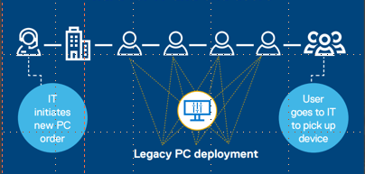
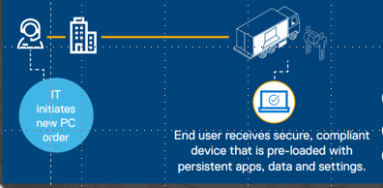
ProDeploy in the Unified Workspace
Traditional imaging and deployment
Dell Provisioning
Traditional PC lifecycle management is time-consuming, labor intensive and expensive. IT teams build, maintain and update the company’s golden image(s) and manually apply this to a new or existing PC when re-imaging. Both processes can take hours depending on organizational requirements, the size of applications and the complexity of task sequences.
Dell devices are factory provisioned with VMware Workspace ONE, pre-loaded with the end-user’s Workspace ONE profile, security and policies and shipped directly to the end-user’s home or office – so that they can start work on the first boot.
Traditional Deployment is hard for IT and end users
Dell Provisioning saves up to nearly a week of IT time per 1,000 devices deployed
For more information please see the ProDeploy in the Unified Workspace Digital Playbook

Slide 11
Tools for Deployment Services

Slide 12
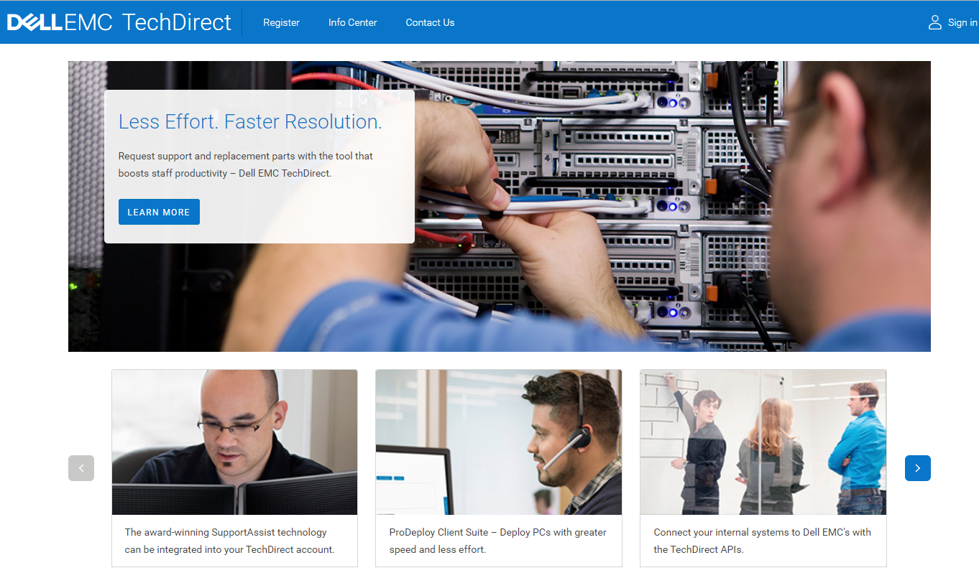
TechDirect
TechDirect.com
Online self-service portal boosts IT productivity for deployment and support
Benefits:
Allows Dell EMC partners to manage their activity and work on behalf of customers
Direct ProDeploy services to deploy PCs with greater speed and less effort
Execute support and replacement parts requests for in-warranty client and enterprise systems
Manage SupportAssist proactive and predictive alerts, enabled by adaptive AI, to help maximize uptime
Insights
Ease
Self-dispatch performance visibility
Progress tracking for certification competency achievement
ProDeploy Client Suite deployment status
Global 24x7 availability
Centralized online account
Responsive design for optimal viewing and navigation on any device
Internal Use - Confidential
Notes:
TechDirect is the online self-service portal designed by our experts to empower the customer. The key benefit of this tool is it boosts customer productivity as they can manage their Dell EMC technology, train their staff and support their end users from a single online account.
Customers see boosts in their IT staff productivity for support and deployment after implementing this tool.
This tool is responsive for an optimal viewing experience, no matter the customer’s device.
From deployment to education and support, TechDirect lets you do more with less effort and faster resolution.
From one central location in TechDirect, configured for multiple users and tasks, you can:
Input system build and deploy details for ProDeploy Client Suite order
Explore ProDeploy Client Suite features using the sample order features with no purchase commitment, prior to placing an order
Configure and manage the technicians in your company to submit technical support requests
Get on-demand access to support requests at no additional charge
Enable eligible technicians to submit parts dispatches via the Self-Dispatch program
Receive proactive and predictive SupportAssist alerts, enabled by machine learning, for PCs
Integrate Dell EMC services functionality into your help desk with APIs
Access and manage deployment certifications as well as authorizations for your technicians
Dell EMC partners can manage their activity as well as work on behalf of their customers with a dedicated Dashboard gadget.
.

Slide 13
TechDirect and ProDeploy Client Suite
Online project management for you and your customer
Create a deployment project without commitment
Set up a customer and guide them through the deployment process
Or let the customer define and track the deployment on their own – you define the access level for your customer
Videos walk you and your customer through the set up and deployment process step by step
Streamlined deployment workflows
Easy, intuitive project definition and process tracking
Dashboard view in your account lets you track orders for multiple customers and deployment projects with one tool
Add-on end-user scheduling for remote workers and multi-site deployments to make appointment scheduling efficient
Use a deployment project to launch your customer’s engagement with TechDirect portal;
then, transition them to support services and handling replacement parts requests for in-warranty client and enterprise systems
Notes:
TechDirect
With channel slant
Easier to track your orders with your customers

Slide 14
Deployment co-delivery

Slide 15
Utilize services capabilities to match your business
Flexible options to grow capabilities and profits
RESELL
DELIVER
CO-DELIVER
Sell Dell Technologies Services
Dell experts handle delivery
Earn rebates
Augment your own capabilities
Sell your own services
You own delivery, leveraging Dell Technologies tools and training
Retain all margin
Market your expertise
Sell Dell Technology Services
Share delivery with Dell experts
Earn rebates
Extend capabilities
Leverage Dell Technologies
Authorized by Dell Technologies
Notes:
As a partner, Dell Technologies has created a business model that gives you options to choose how you include services in your deals
Resell – Sell Dell Technologies Services. Dell handles the delivery, and you earn rebates based off of the services
Deliver your own services – You complete the required competency and sell and deliver 100% of the services on your own. You own the delivery process, but are trained and backed by Dell Technologies – increasing your credibility.
Co-deliver – You complete the required competencies, Sell Dell Technologies Services, and deliver a subset of services alongside Dell Technologies. You increase profitability, increase credibility, and improve sales relationships
We want to help you to increase profitability, increase your credibility with customers, and improve sales relationships so we can continue to drive sales together.

Slide 16
Winning together with co-delivery
Leverage your competencies, earn rebates, grow profitability
Resell Dell Technologies Services
Jointly deliver with Dell Technologies
Receive reimbursement
Earn rebates on eligible services
Market your capabilities
Notes:
The value of winning together with co-delivery
For Client co-delivery, a partner is required to have a client deployment competency.
When a partner decides to add the co-deliver option to their deployment model, they are deciding to increase their credibility and profitability, and grow better sales relationships.
A partner would complete the required deployment competencies utilizing Dell Technologies training. Once completed, Dell Technologies would review and grant access to co-deliver.
Once an opportunity arises where co-delivery is the perfect option a partner would
Resell Dell Technologies Services
Jointly deliver with Dell Technologies
Giving access to and utilization of Dell Technologies training, best practices, and tools
Receive reimbursement
Earn rebates on eligible services
Co-delivery allows your partner to market their capabilities and work alongside Dell Technologies, increasing credibility to our customers.

Slide 17
Co-Delivery options for authorized partners
Authorized partners can resell the Services below and be reimbursed for their delivery efforts
ProDeploy Client Suite
Client Installation Services
Deskside installation phase of ProDeploy or ProDeploy Plus
Configuration
Logistics
Component setup
Software installation
System configuration
Operating system installation
Imaging
Up to 30-day storage
Packaging Management
Dell team delivers configuration services
Dell team delivers on-site installation
Notes:
Co-delivery of deployment services offers channel partners many benefits, including:
Enhanced partnership with Dell Sales
Enhanced services delivery credentials
Seamless integration with Dell brand
Utilization of their services team and continuity with end customer
Inclusion on exclusive “find a partner on the Partner” portal
Dell Technologies Deployment full offer provides multiple opportunities for co-delivery with lucrative reimbursement rates that greatly enhance your margin share of the resell.
Please see the Client Deployment Co-delivery Partner Training and the Services Delivery Competency Training for more information.

Slide 18
Resources

Slide 19
Client deployment resources
Services offer resources
ProDeploy Client Suite Knowledge Center
for partner and customer marketing assets: https://www.dellemc.com/resources/en-us/auth/services/deployment/deployment-services-for-client-solutions/configuration-and-deployment-services.htm#sort=relevancy&numberOfResults=25
Client Installation Service Knowledge Center
for partner and customer marketing assets:
https://www.dellemc.com/resources/en-us/auth/services/deployment/deployment-services-for-client-solutions/client-installation-service.htm#sort=relevancy&numberOfResults=25
Modern Provisioning Knowledge Center
for sales training and customer marketing assets: https://www.dellemc.com/resources/en-us/auth/services/deployment/deployment-services-for-client-solutions/modern-provisioning.htm#sort=relevancy&numberOfResults=25
Unified Workspace Knowledge Center
for partner and customer marketing assets:
https://www.dellemc.com/resources/en-us/auth/products/unified-workspace/unified-workspace/dell-technologies-unified-workspace.htm#sort=relevancy&numberOfResults=25
For best results with links, please copy and paste into a browser

Slide 20
Client deployment resources
Services offer resources
Configuration and Deployment Services Knowledge Center for partner and customer marketing assets:
https://www.dellemc.com/resources/en-us/auth/services/deployment/deployment-services-for-client-solutions/configuration-and-deployment-services.htm#sort=relevancy&numberOfResults=25
Asset Recovery and Recycling Knowledge Center
for partner and customer marketing assets:
https://www.dellemc.com/resources/en-us/auth/services/deployment/deployment-services-for-client-solutions/asset-resale-and-recycling-deployment-services-for-client-soluti.htm#sort=relevancy&numberOfResults=25
TechDirect Sales Training
https://www.dellemc.com/resources/en-us/auth/asset/training/services/TechDirect_Sales_Training.pptx
URLs:
Client Deployment Assessment training
https://www.dellemc.com/resources/en-us/auth/asset/training/services/Client-Deployment-Assessment-Training.pptx.external
ProDeploy in the Unified Workspace Digital Playbook
https://www.dellemc.com/resources/en-us/auth/asset/playbooks/products/dell-technologies-cloud/dell-prodeploy-in-the-unified-workspace-playbook.pdf.external
For best results with links, please copy and paste into a browser

Slide 21
Client deployment co-deliver resources and contacts
Co-deliver information
Delivering Deployment Services Knowledge Center
https://www.dellemc.com/resources/en-us/auth/services/deployment/deployment-services-for-infrastructuresolutions/Delivering_Deployment_Services.htm#sort=relevancy&numberOfResults=25
Deployment Services Delivery Guide
https://www.dellemc.com/resources/en-us/auth/asset/quick-reference-guides/partner/services-delivery-enablement-benefits-and-requirements.pdf
Services Delivery Benefits and Requirements guide
https://www.dellemc.com/resources/en-us/auth/asset/quick-reference-guides/partner/services-delivery-enablement-benefits-and-requirements.pdf
For questions related to co-deliver, contact the team: Open case with Channel Services Helpdesk or contact your Channel Sales Representative.
URLs:
Customer Facing Find A Partner Tool
https://www.dellemc.com/partner/en-us/partner/find-a-partner.htm
Certified Partner Program Guide
https://www.dellemc.com/partner/en-us/asset/quick-reference-guides/partner/Partner_Program_Overview.pdf
Services Delivery Enablement Matrix
https://www.dellemc.com/partner/en-us/auth/services/delivering-services.htm
For best results with links, please copy and paste into a browser

Slide 22
Client co-deliver resources and contacts
For questions related to co-deliver, contact the team:
Open case with Channel Services Helpdesk or contact your Channel Sales Representative.
URLs:
Customer Facing Find A Partner Tool https://www.dellemc.com/partner/en-us/partner/find-a-partner.htm
Certified Partner Program Guide
https://www.dellemc.com/partner/en-us/asset/quick-reference-guides/partner/Partner_Program_Overview.pdf
Services Delivery Enablement Matrix
https://www.dellemc.com/partner/en-us/auth/services/delivering-services.htm
Dell Technologies Partner Academy training:
Services sales training: https://education.emc.com/content/emc/en-us/home/bpa_homepage/accelerate-services-resale.html
Services delivery competency training: https://education.emc.com/content/emc/en-us/home.html
For best results with links, please copy and paste into a browser

